Slide 1
Faces in the Clouds: Time-Domain Attribute based access control for cloud-based video content sharing
BATCH-18
GUIDE: Ms. Maheshwari
MOHANASREE.P [211417104148]
MAHALAKSHMI.D [211417104139]

Slide 2
Introduction
Cloud computing is the delivery of on-demand computing services.
Benefit of using cloud computing services:
Cloud computing works by allowing client devices to access data over the internet, from remote servers, databases and computers.
Communications between the front and back ends are managed by a central server.
firms can avoid the upfront cost
complexity of owning
maintaining their own IT infrastructure
significant economies of scale

Slide 3
Literature Survey
Authors | Title | Description
Shan-Hsiang Shen | Efficient SVC Multicast Streaming for Video Conferencing With SDN Control | Proposed a novel SVC multicast streaming scheme named adaptive SDN-based SVC multicast (ASCast).
Mohammad H. Hajiesmaili, Lok To Mak, Zhi Wang, Chuan Wu, Minghua Chen, and Ahmad Khonsari | Cost-Effective Low-Delay Design for Multi-Party Cloud Video Conferencing | Paper discusses a joint problem of user-to-agent assignment and transcoding-agent selection.
Deming Zhai, Xianming Liu, Xiangyang Ji | Joint Gaze Correction and Face Beautification for Conference Video using Dual Sparsity Prior | Paper proposes to jointly solve the hole-filling problem and the face beautification problem using dual sparsity prior.
Yuanhuan Zheng, Di Wu, Yihao Ke, Can Yang | Online Cloud Transcoding and Distribution for Crowdsourced Live Game Video Streaming | They address the problem of cost-effective adaptive live game video streaming from the perspective of CLGVS service providers.
Xiangbo Li, Mohsen Amini Salehi, Magdy Bayoumi | Cost-Efficient and Robust On-Demand Video Stream Transcoding Using Heterogeneous Cloud Services | They proposed an idea to transcode them in an on-demand (i.e., lazy) manner using cloud computing services.

Slide 4
Problem Statement
This project studies the problem of resource allocations in the cloud for media streaming applications. We have considered non-linear time-discount tariffs that a cloud provider charges for resources reserved in the cloud.
We develop a resource allocation system that can avoid overload in the system effectively while minimizing the number of servers used.

Slide 5
Technology Stack
H/W SYSTEM CONFIGURATION:
Processor - Pentium –III
RAM - 8 GB
Hard Disk - 260 GB
Key Board - Standard Windows Keyboard
Mouse - Two or Three Button Mouse
Monitor - SVGA
S/W SYSTEM CONFIGURATION:
Operating System - Windows95/98/2000/XP
Front End - HTML, Java, Jsp
Scripts - JavaScript.
Server-side Script - Java Server Pages.
Database - My sql
Database Connectivity - JDBC.

Slide 6
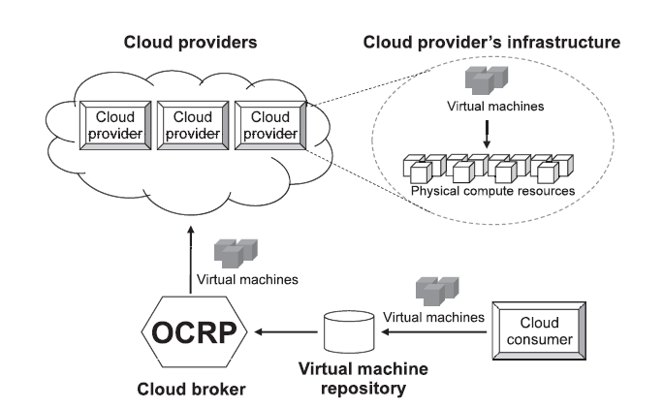
System Architecture

Slide 7
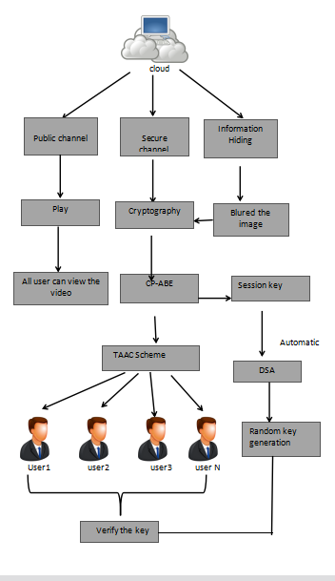
Block Diagram:

Slide 8
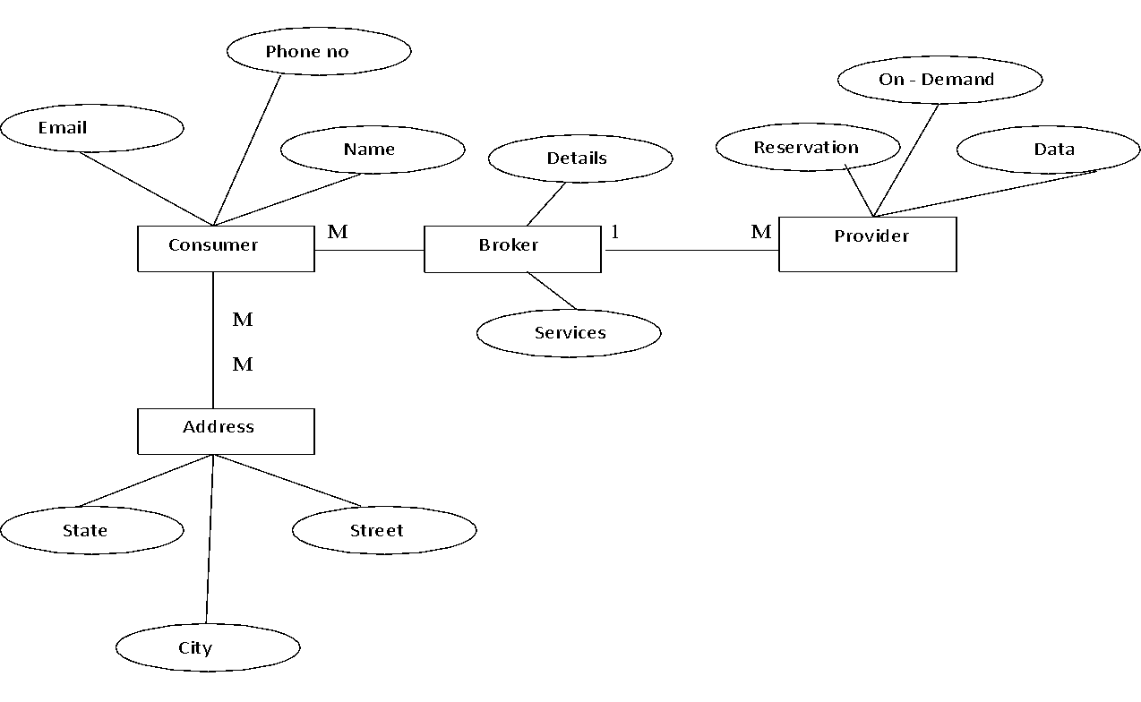
ER Diagram:

Slide 9
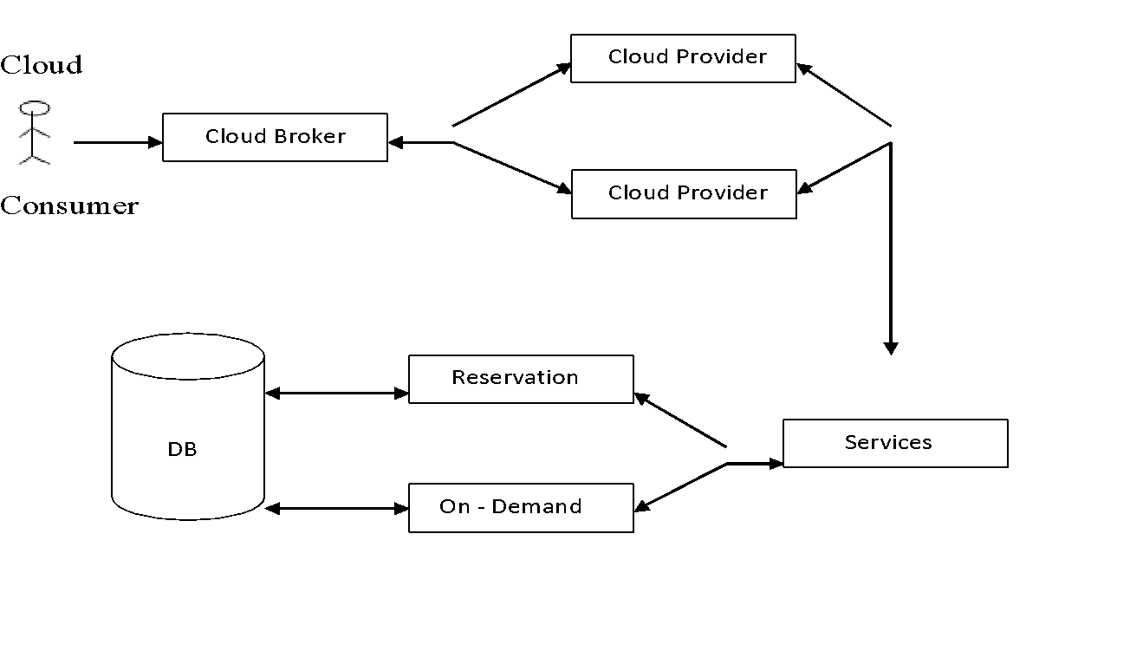
Data Flow Diagram:

Slide 10
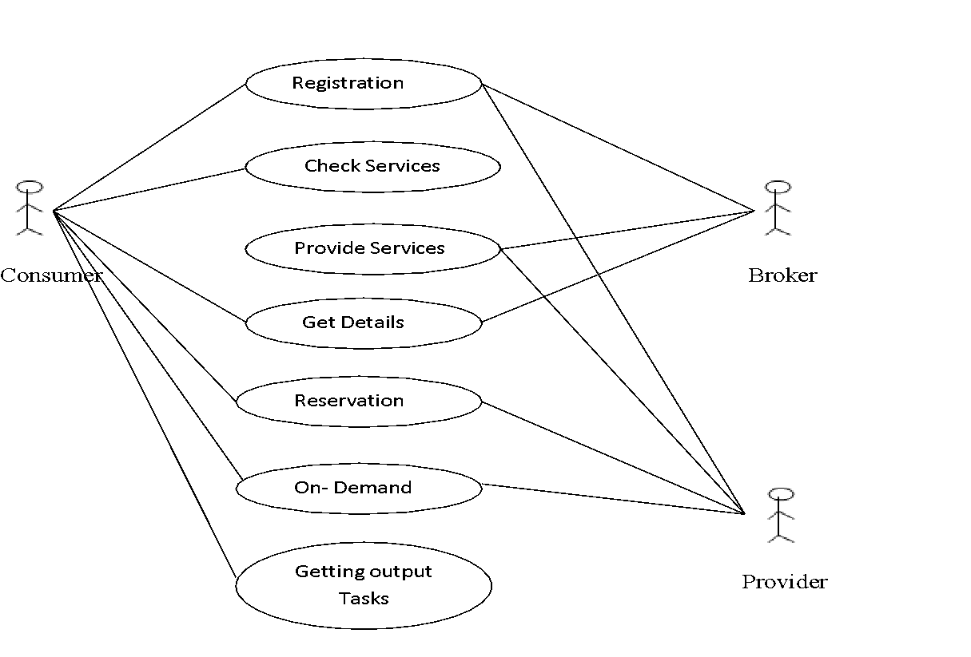
Use Case Diagram:

Slide 11
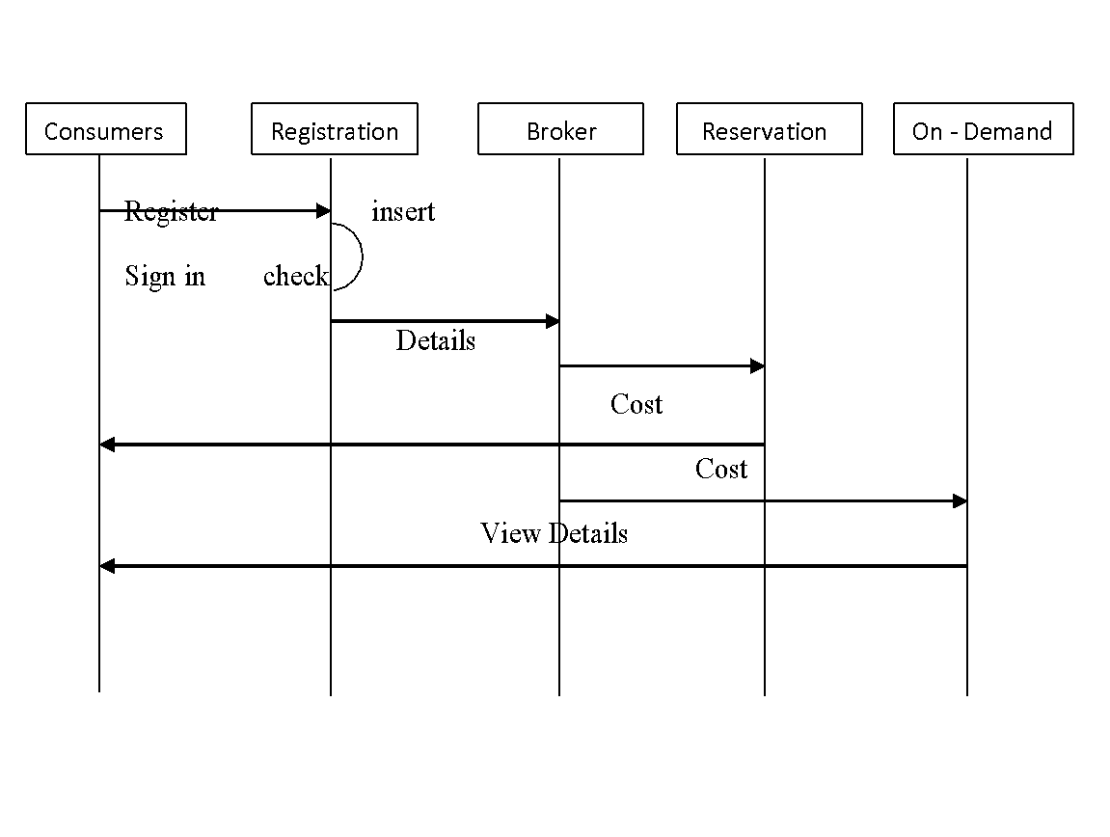
Sequence Diagram:

Slide 12
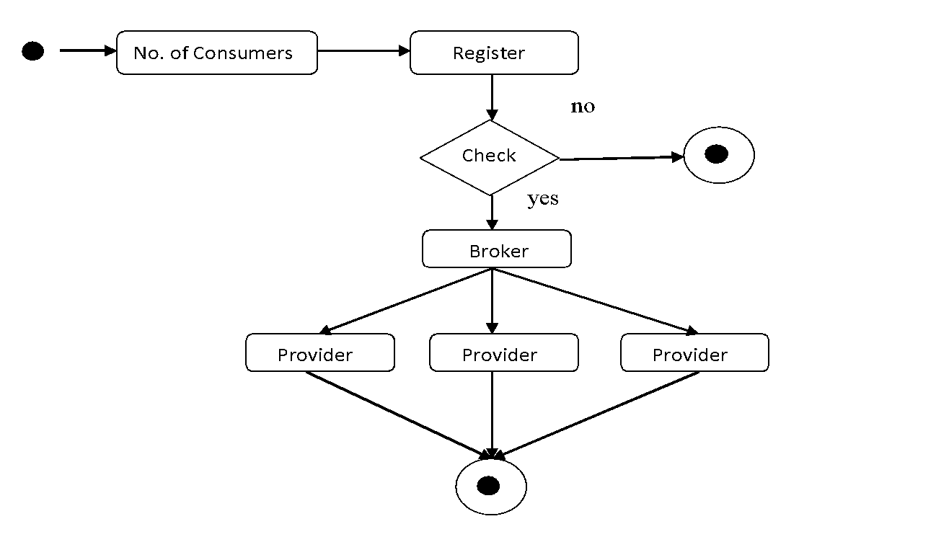
UML Diagram:

Slide 13
MODULES:
Resource Provisioning (RP)
Overload avoidance
Minimizing skewness
VM Migrations

Slide 14
RESOURCE PROVISIONING(RP)
An optimal cloud resource provisioning is proposed by formulating a stochastic programming model.
RP algorithm can provision computing resources for being used in multiple provisioning stages as well as a long-term plan, e.g., four stages in a quarter plan and twelve stages in a yearly plan. The demand and price uncertainty is considered in RP.
In particular, an optimal cloud resource provisioning is proposed to minimize the total cost for provisioning resources in a certain time period.
To make an optimal decision, the demand uncertainty from cloud consumer side and price uncertainty from cloud providers are taken into account to adjust the tradeoff between on-demand and oversubscribed costs.

Slide 15
OVERLOAD AVOIDANCE
An important issue when operating a load-balanced service is how to handle information that must be kept across the multiple requests in a user's session. If this information is stored locally on one backend server, then subsequent requests going to different backend servers would not be able to find it.
This might be cached information that can be recomputed, in which case load-balancing a request to a different backend server just introduces a performance issue.
A variety of scheduling algorithms are used by load balancers to determine which backend server to send a request to.
Simple algorithms include random choice or round robin. More sophisticated load balancers may take into account additional factors, such as a server's reported load, recent response times, up/down status (determined by a monitoring poll of some kind), number of active connections, geographic location, capabilities, or how much traffic it has recently been assigned.

Slide 16
MINIMIZING SKEWNESS
Application delivery controllers have evolved from basic server load balancing functional units to fully integrate with cloud workflows and provisioning systems.
So that they help users enable fast roll-out of new applications to a mobilized work force, improve end-user satisfaction, and reduce the time and cost of application deployment.
We introduce the concept of skewness to quantify the unevenness in the utilization of multiple resources on a server.

Slide 17
VM MIGRATIONS
We aim to migrate away the VM that can reduce the server’s Usage the most. In case of ties, we select the VM whose removal can reduce the skewness of the server the most. For each VM in the list, we see if we can find a destination server to accommodate it. The server must not become a hot spot after accepting this VM.
Among all such servers, we select one whose skewness can be reduced the most by accepting this VM. Note that this reduction can be negative which means we select the server whose skewness increases the least. If a destination server is found, we record the migration of the VM to that server and update the predicted load of related servers. Otherwise, we move onto the next VM in the list and try to find a destination server for it.
As long as we can find a destination server for any of its VMs, we consider this run of the algorithm a success and then move onto the next hot spot. Note that each run of the algorithm migrates away at most one VM from the overloaded server. This does not necessarily eliminate the hot spot, but at least reduces its temperature.
If it remains a hot spot in the next decision run, the algorithm will repeat this process. It is possible to design the algorithm so that it can migrate away multiple VMs during each run. But this can add more load on the related servers during a period when they are already overloaded.

Slide 18
Testing:
UNIT TESTING:
Unit testing involves the design of test cases that validate that the internal program logic is functioning properly, and that program input produces valid outputs. All decision branches and internal code flow should be validated. It is the testing of individual software units of the application .it is done after the completion of an individual unit before integration. This is a structural testing, that relies on knowledge of its construction and is invasive. Unit tests perform basic tests at component level and test a specific business process, application, and/or system configuration. Unit tests ensure that each unique path of a business process performs accurately to the documented specifications and contains clearly defined inputs and expected results.
INTEGRATION TESTING:
Software integration testing is the incremental integration testing of two or more integrated software components on a single platform to produce failures caused by interface defects.
The task of the integration test is to check that components or software applications, e.g., components in a software system or – one step up – software applications at the company level – interact without error.

Slide 19
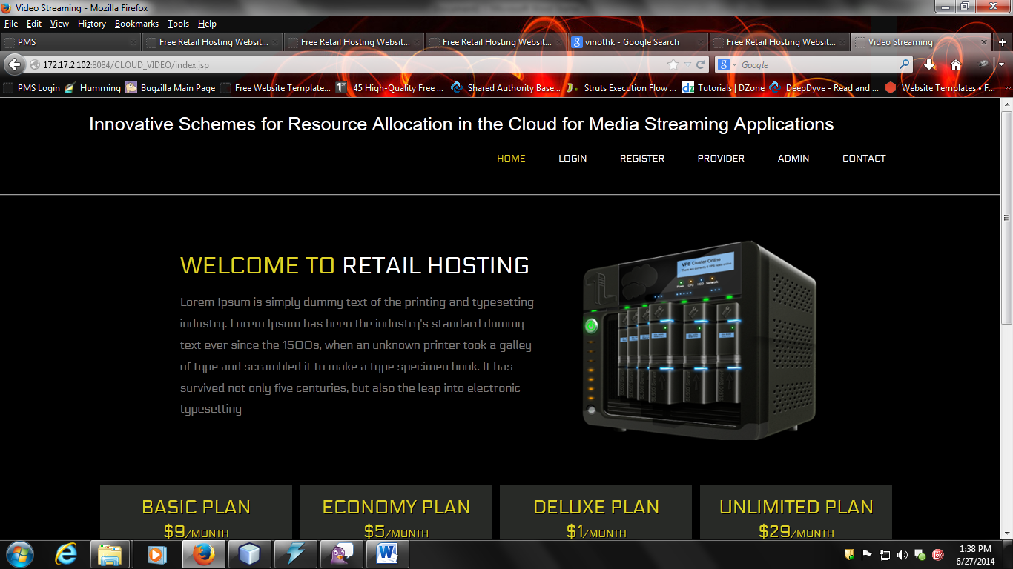
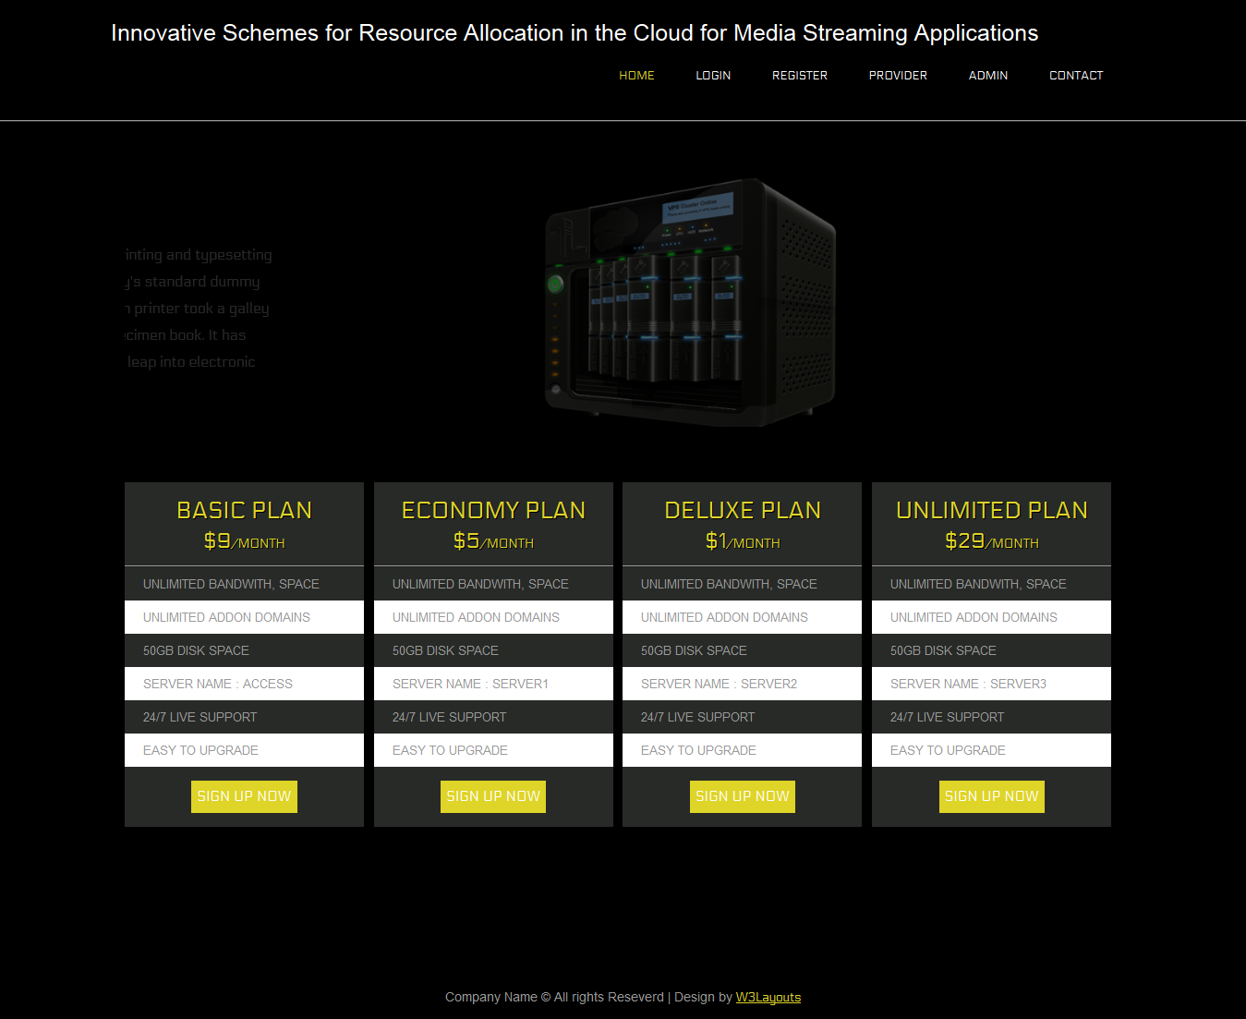

Slide 20
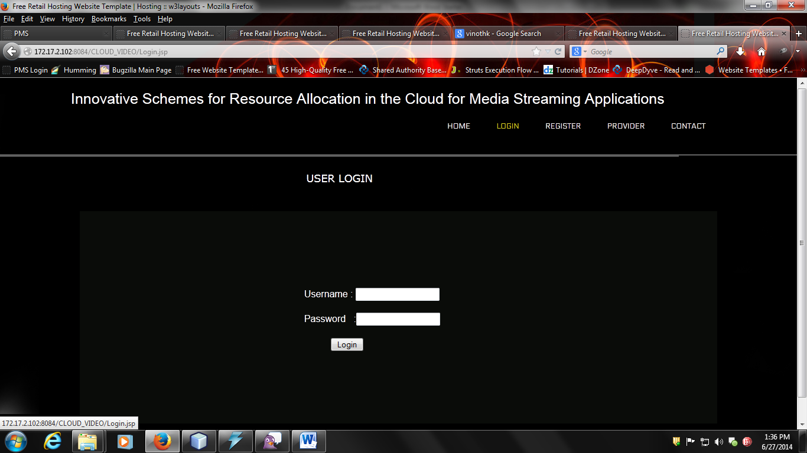
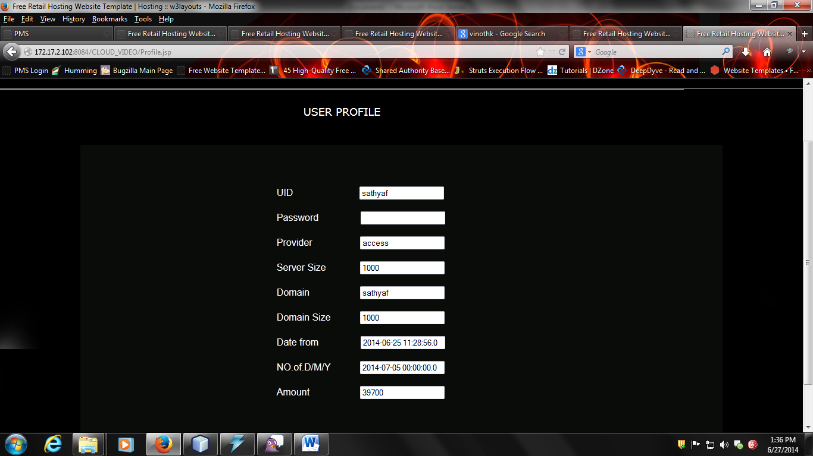

Slide 21
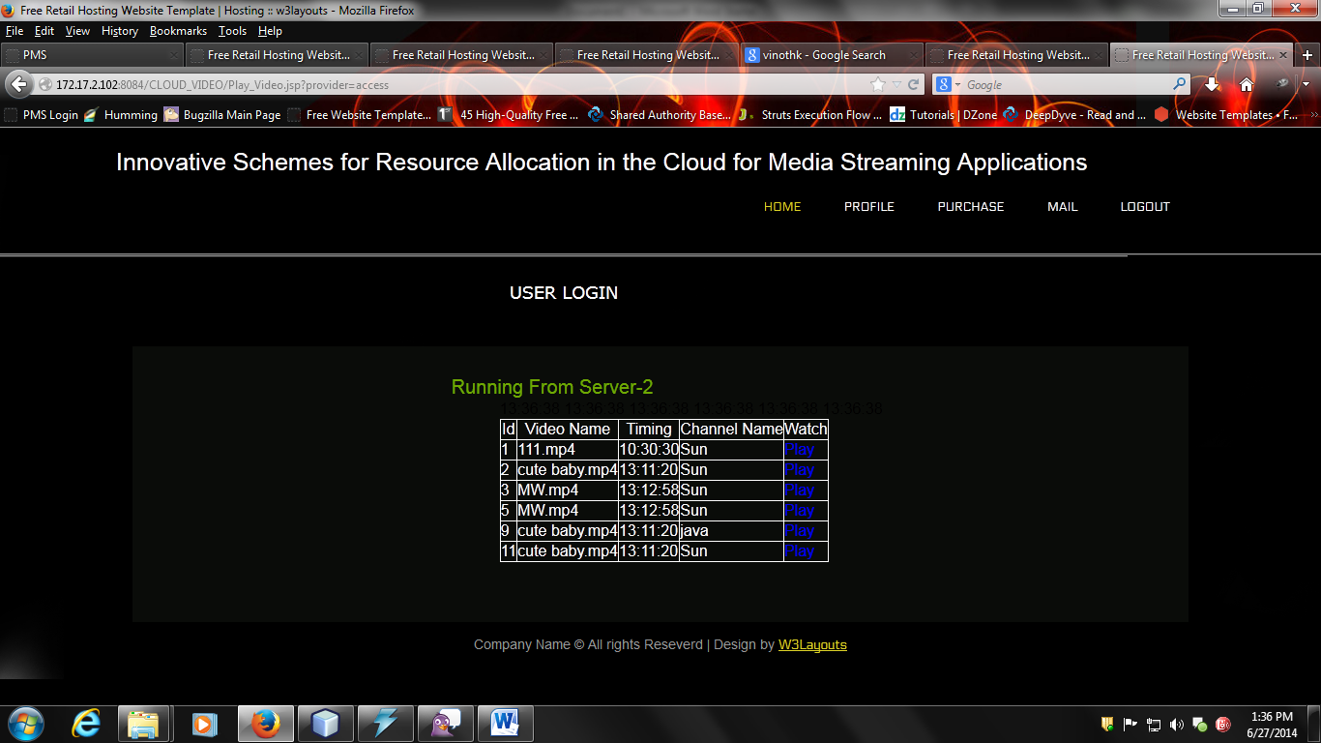
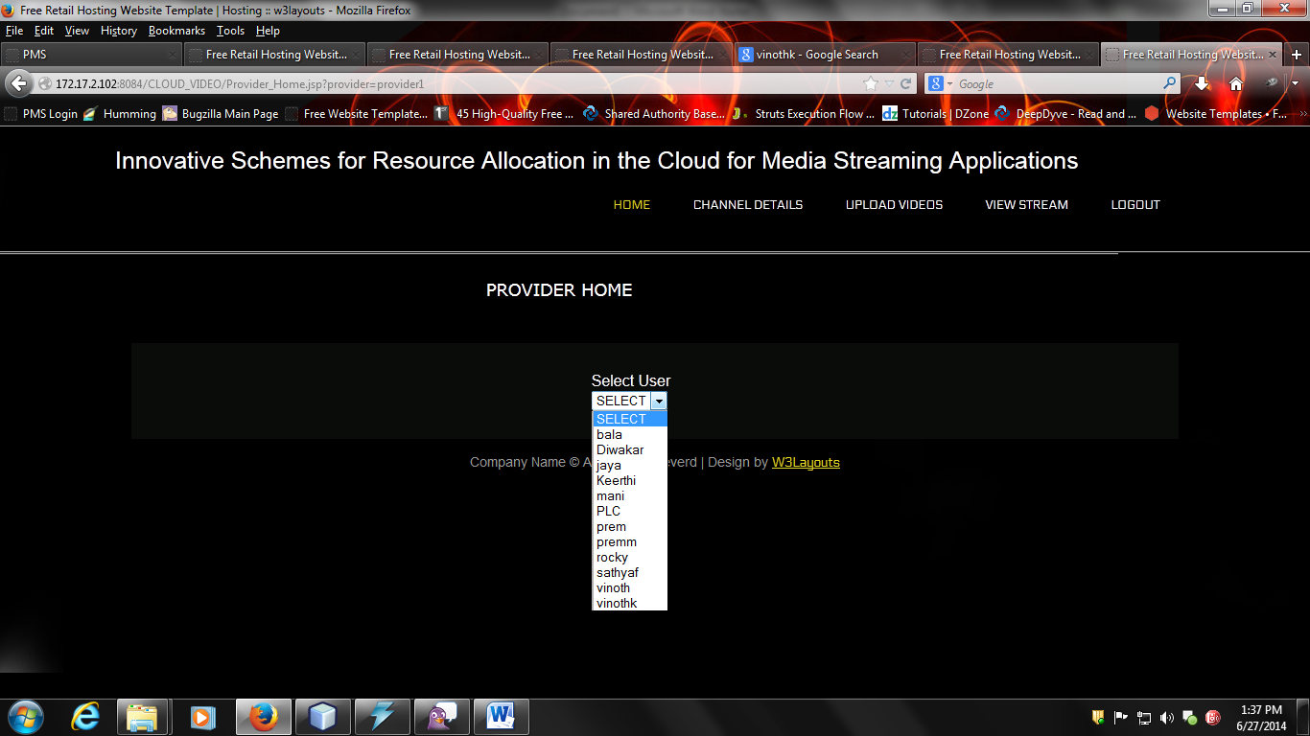

Slide 22
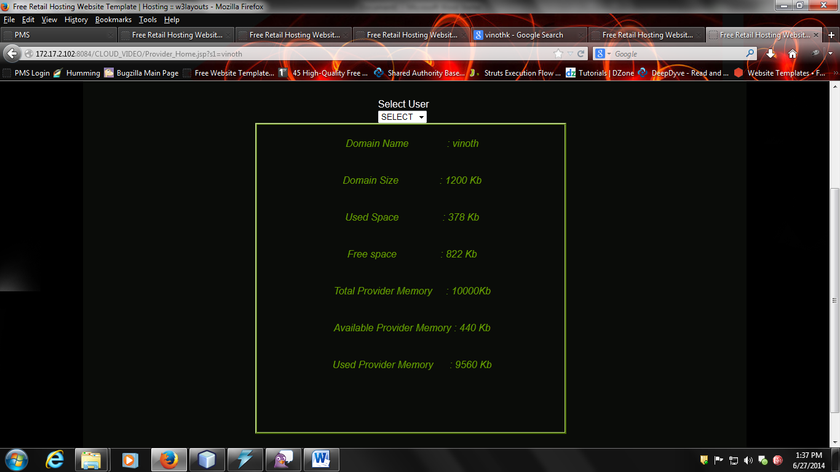
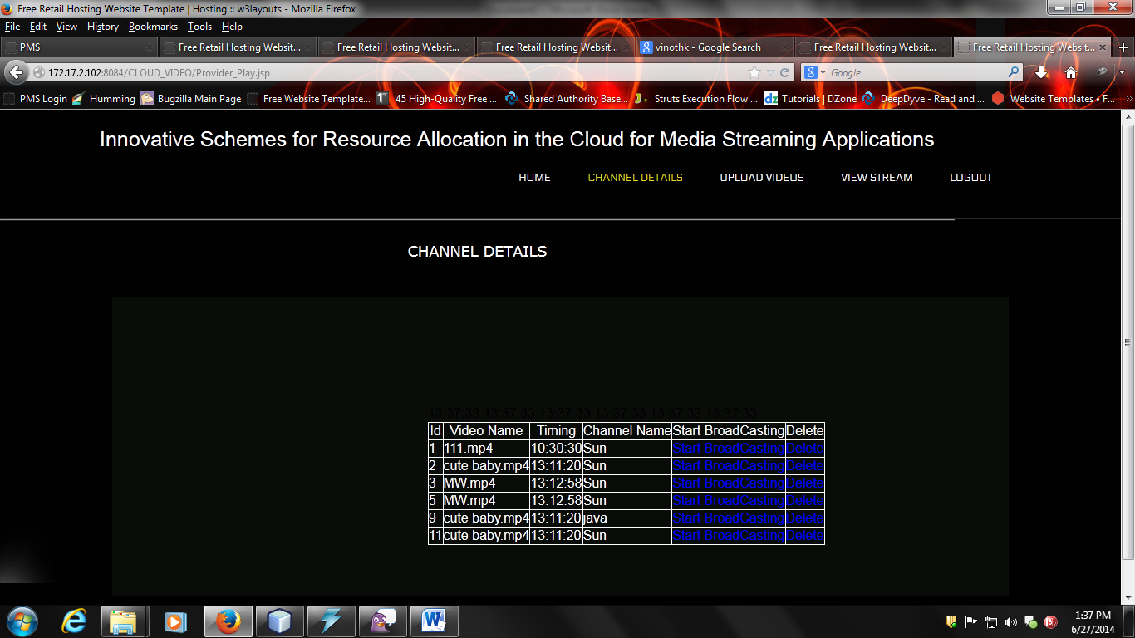

Slide 23
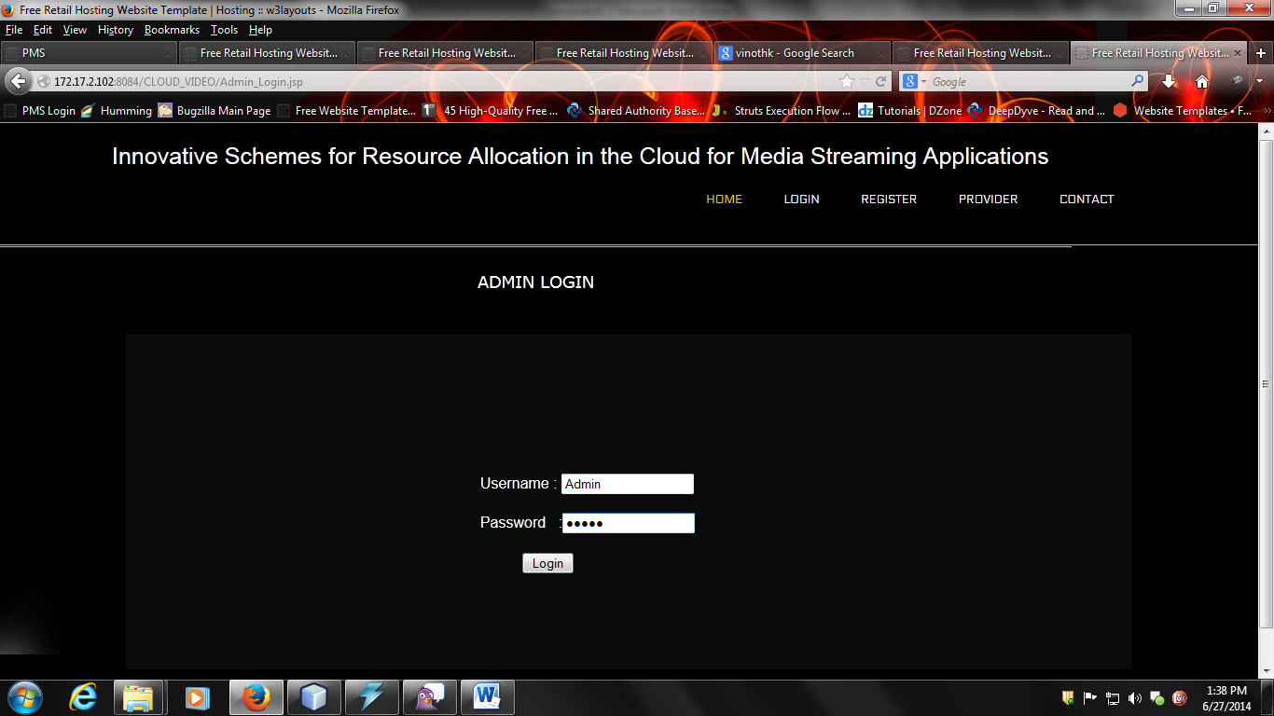
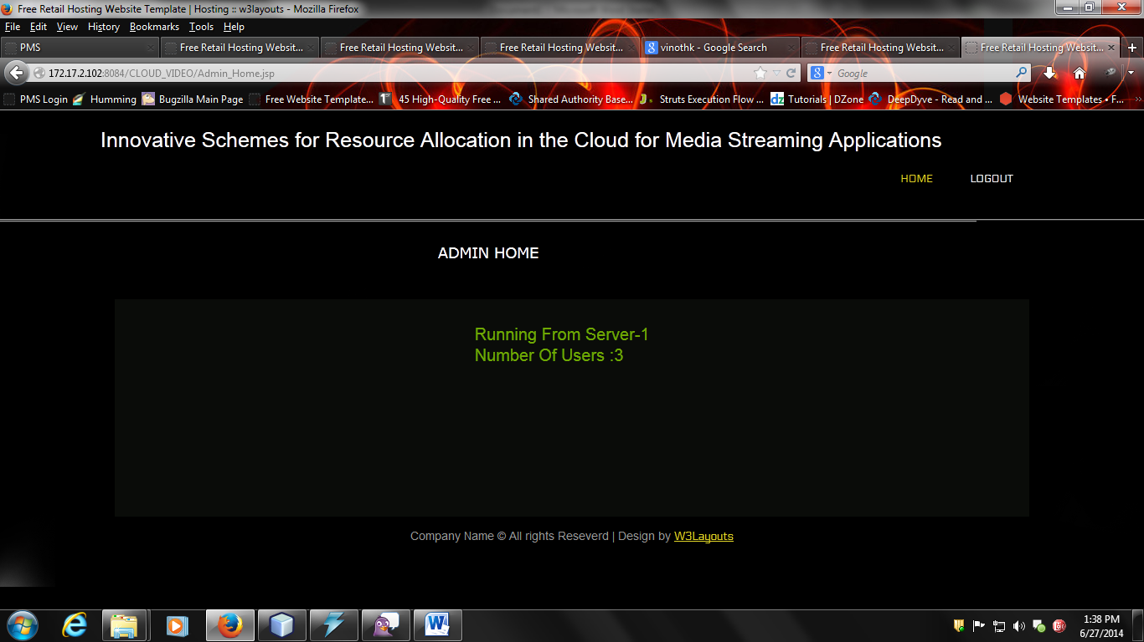

Slide 24
Conclusion
In this project considers recreations of a multi-client, cloud assisted worldwide video conferencing framework.
We accept a video switch (for example as created by the Vconnect venture) that can move between the cloud facilitated areas in a user transparent way.
Utilizing sensible interest from genuine world information, we examined two diverse interest situations (one in view of gaming the other dependent on instruction).
We thought about situations where video switch areas were chosen statically what's more, progressively. Our analyses were rushed to decide the postpone experienced by clients because of the decisions of cloud have area and courses for their video session.

Slide 25
References:
[1] Shan-Hsiang Shen, “Efficient SVC Multicast Streaming for Video Conferencing with SDN Control,” IEEE Transactions on Network and Service Management, vol. 16, pp. 403 - 416, June 2019.
[2] E. Coronado, R. Riggio, J. Villalón, and A. Garrido, “Efficient real-time content distribution for multiple multicast groups in SDNbased WLANs,” IEEE Trans. Netw. Service Manag., vol. 15, no. 1, pp. 430–443, Mar. 2018.
[3] Mohammad H. Hajiesmaili, Lok To Mak, Zhi Wang, Chuan Wu, Minghua Chen, and Ahmad Khonsari, “Cost-Effective Low-Delay Design for Multiparty Cloud Video Conferencing, ” in IEEE Transactions on Multimedia, vol: 19, pp. 2760 - 2774, Dec. 2017
[4] A. Bentaleb, A. C. Begen, R. Zimmermann, and S. Harous, “SDNHAS: An SDN-enabled architecture to optimize QoE in HTTP adaptive streaming,” IEEE Trans. Multimedia, vol. 19, no. 10, pp. 2136–2151, Oct. 2017.
[5] S. Y. Shah, B. Szymanski, P. Zerfos, and C. Gibson, “Towards relevancy aware service-oriented systems in wsns,” IEEE Transactions on Service Computing, vol. 8, 2015.

